Slide 1
CLASS 8 and 9
Dated 10th FEBRUARY and 3rd March 2025
Course Title: 5G and Wireless Technology
Course Code : ECE829
MODULE 4 of the Syllabus:-
RAN TEST BEDs and DEMOs
with USE CASE 1 and USE CASE 2
Prof.(Dr.) Rabindranath Bera (Professor, IIIT, KALYANI)
E-mail: rbera@iiitkalyani.ac.in; Mobile : 9475513358

Slide 2
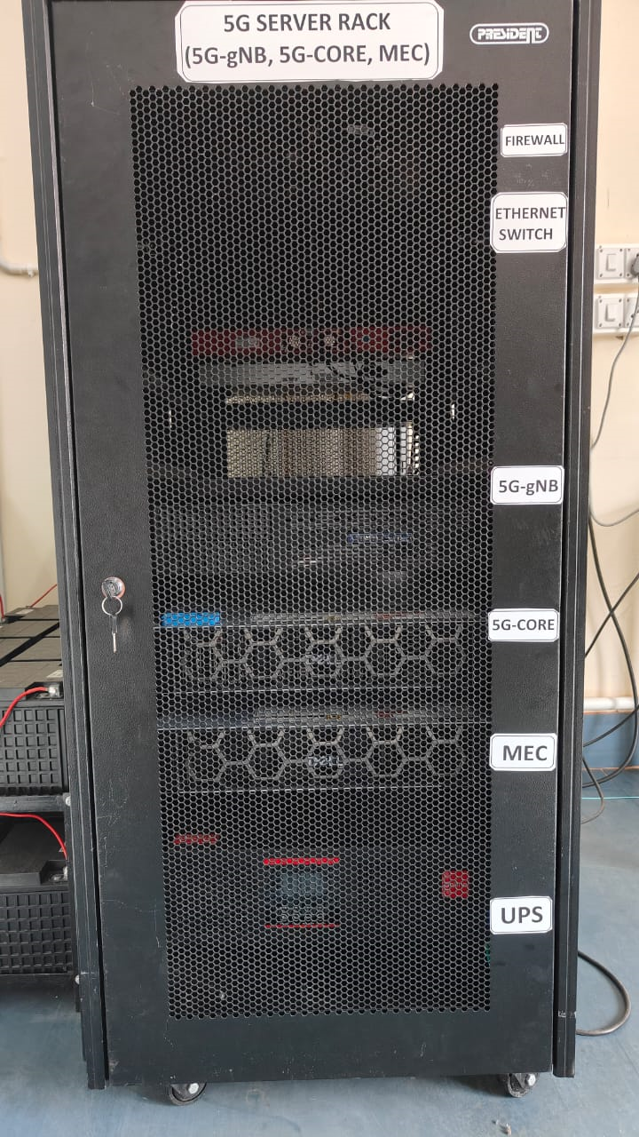

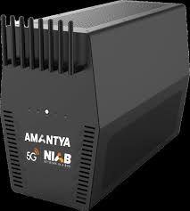
Motivation
‘ONE BOX NIB (Network-In-a-Box) Implementation’ : of 5G Split Open v-RAN
‘LARGE RACK Implementation’: of 5G Split Open
v-RAN Architecture
[OPERATIONAL at IIIT, KALYANI] [ PROPOSED DEVELOPMENT at IIIT, KALYANI]
5G NIB Portable Base Station carryable in a bag
New Era in RAN Evaluation
140 GHz 6G NIB ensures URLLC
LAPTOP /Raspberry PI type Computer within NIB as Portable Data Center

Slide 3
Motivation : INTER-OPERABILITY among LARGE RACK 5G and NIBs and their INTEGRATION solves major RAN Problems

Slide 4
Outline of Presentation
5G RAN ARCHITECTURE Further Evoluation
‘LARGE RACK Implementation’: of 5G Split Open v-RAN Architecture revisited
Use Case 1: Large Rack Implementation at IIIT , Kalyani
‘ONE BOX NIB (Network-In-a-Box) Implementation’ : of 5G Split Open v-RAN Architecture
WEBINAR 1: Unlocking the True Potential of 5G with Network-in-a-box [ https://www.youtube.com/watch?v=5peyqzkgfXc&t=4s]
WEBINAR 2: Exploring the Benefits of 5G Labs for Colleges and Universities | Amantya Technologies [ https://www.youtube.com/watch?v=zh9XJPZlGQw]
Review on ‘5G/6G NIB’ (Network-In-a-Box): Objective, Paper 1 Edge Task Migration With 6G-Enabled Network in Box for Cybertwin-Based Internet of Vehicles
INTER-OPERABILITY among LARGE RACK 5G and NIBs and their INTEGRATION
Use Case 2: IIIT KALYANI Debuts Smart Island (Running Project ) with DELL Servers having Intel® Xeon Gold 3.0 GHz 5317 x 2 processor
Project ‘SMART_GANGASAGAR ’ sponsored by DRDO: IIIT, KALYANI 5G O-RAN / V-RAN Architecture DEPLOYMENTS over SEA/ISLAND Communication at or surrounding Gangasagar with Five Cells
5G NIB with One Cell Use Case during Short Stretch of Journey over Sea Water Channel:
AI enabled 5G Vessels with 5G URLLC Slice operational at Gangasagar Island
5G NIB with Three CELLs Use cases during Long Stretch of Journey over Sea Water Channel: :
Ensuring Service Continuity in Integrated Terrestrial and Non-Terrestrial Network (TN-NTN) and Use Cases in Water Vehicles with Infotainment, IoT and IoV services
5G NIB with Five CELLs Use cases for above service extension at or nearby areas surrounding Gangasagar Island:
Design and Implementation of 5G-Advanced Infrastructure 2.0 based Private Network at nearby areas surrounding Gangasagar Island

Slide 5
Outline of Presentation
5G RAN ARCHITECTURE Further Evoluation
‘LARGE RACK Implementation’: of 5G Split Open v-RAN Architecture revisited
Use Case 1: Large Rack Implementation at IIIT , Kalyani
‘ONE BOX NIB (Network-In-a-Box) Implementation’ : of 5G Split Open v-RAN Architecture
WEBINAR 1: Unlocking the True Potential of 5G with Network-in-a-box [ https://www.youtube.com/watch?v=5peyqzkgfXc&t=4s]
WEBINAR 2: Exploring the Benefits of 5G Labs for Colleges and Universities | Amantya Technologies [ https://www.youtube.com/watch?v=zh9XJPZlGQw]
Review on ‘5G/6G NIB’ (Network-In-a-Box): Objective, Paper 1 Edge Task Migration With 6G-Enabled Network in Box for Cybertwin-Based Internet of Vehicles
INTER-OPERABILITY among LARGE RACK 5G and NIBs and their INTEGRATION
Use Case 2: IIIT KALYANI Debuts Smart Island (Running Project ) with DELL Servers having Intel® Xeon Gold 3.0 GHz 5317 x 2 processor
Project ‘SMART_GANGASAGAR ’ sponsored by DRDO: IIIT, KALYANI 5G O-RAN / V-RAN Architecture DEPLOYMENTS over SEA/ISLAND Communication at or surrounding Gangasagar with Five Cells
5G NIB with One Cell Use Case during Short Stretch of Journey over Sea Water Channel:
AI enabled 5G Vessels with 5G URLLC Slice operational at Gangasagar Island
5G NIB with Three CELLs Use cases during Long Stretch of Journey over Sea Water Channel: :
Ensuring Service Continuity in Integrated Terrestrial and Non-Terrestrial Network (TN-NTN) and Use Cases in Water Vehicles with Infotainment, IoT and IoV services
5G NIB with Five CELLs Use cases for above service extension at or nearby areas surrounding Gangasagar Island:
Design and Implementation of 5G-Advanced Infrastructure 2.0 based Private Network at nearby areas surrounding Gangasagar Island

Slide 6
5G RAN Architecture
The 5G RAN radio access architecture consists of two basic elements as follows:
• Central Unit (CU), which is intended to handle relatively higher layers above the physical layer. The physical realization of CU could be either dedicated hardware or a radio-cloud type of implementation. The CU is connected on one hand to the Distributed Unit (DU) and on the other hand to the 5G core network (Next Generation Core (NGC), as shown in Figure 5.5.
• The DU, which is located on the cell site together with the antennas and the RF unit.The DU is expected to handle especially time-critical processing which does not tolerate too much delay to enable processing away from the cell site.
In the considerations in 3GPP, the approach with RF only on the site (with antennas)has not been considered desirable due to the very high transmission requirements of sending IQ samples.

Slide 7
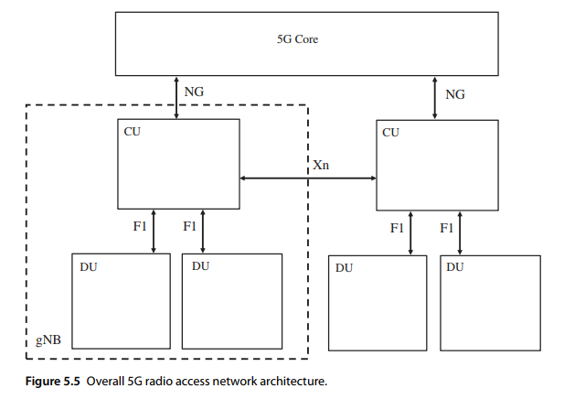

Slide 8
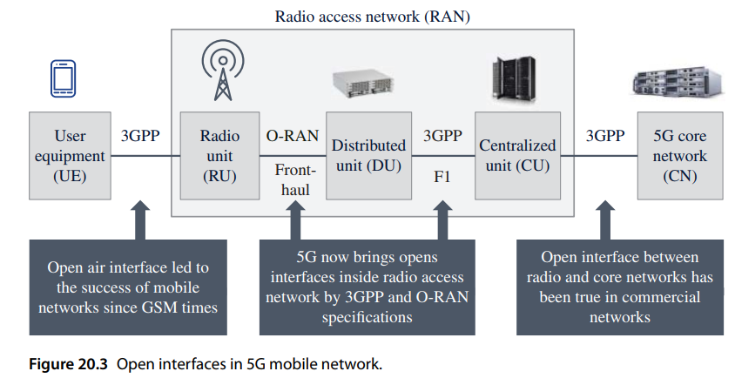

Slide 10
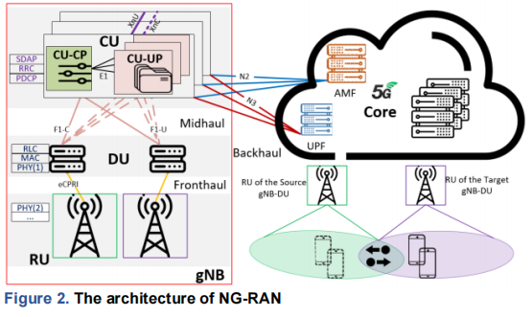
The architecture, as depicted in Figure 2, divides gNB functions into gNB-CU, gNB-DU, and gNB-RU, which connect with the 5G core (5GC) – specifically to AMF (Access and Mobility Function)

Slide 11
‘LARGE RACK Implementation’: of 5G Split Open
v-RAN Architecture
[OPERATIONAL at IIIT, KALYANI]

Slide 12
Outline of Presentation
5G RAN ARCHITECTURE Further Evoluation
‘LARGE RACK Implementation’: of 5G Split Open v-RAN Architecture revisited
Use Case 1: An exemplary illustration of the inter-gNB-DU handover scenario for vehicular communications.
‘ONE BOX NIB (Network-In-a-Box) Implementation’ : of 5G Split Open v-RAN Architecture with AI ADD on
WEBINAR 1: Unlocking the True Potential of 5G with Network-in-a-box [ https://www.youtube.com/watch?v=5peyqzkgfXc&t=4s]
WEBINAR 2: Exploring the Benefits of 5G Labs for Colleges and Universities | Amantya Technologies [ https://www.youtube.com/watch?v=zh9XJPZlGQw]
Review on ‘5G/6G NIB’ (Network-In-a-Box): Objective, Paper 1, Paper 2:
INTER-OPERABILITY among LARGE RACK 5G and NIBs and their INTEGRATION
Use Case 2: IIIT KALYANI Debuts Smart Island (Running Project ) with DELL Servers having Intel® Xeon Gold 3.0 GHz 5317 x 2 processor
Project ‘SMART_GANGASAGAR ’ sponsored by DRDO: IIIT, KALYANI 5G O-RAN / V-RAN Architecture DEPLOYMENTS over SEA/ISLAND Communication at or surrounding Gangasagar with Five Cells
5G NIB with One Cell Use Case during Short Stretch of Journey over Sea Water Channel:
AI enabled 5G Vessels with 5G URLLC Slice operational at Gangasagar Island
5G NIB with Three CELLs Use cases during Long Stretch of Journey over Sea Water Channel: :
Ensuring Service Continuity in Integrated Terrestrial and Non-Terrestrial Network (TN-NTN) and Use Cases in Water Vehicles with Infotainment, IoT and IoV services
5G NIB with Five CELLs Use cases for above service extension at or nearby areas surrounding Gangasagar Island:
Design and Implementation of 5G-Advanced Infrastructure 2.0 based Private Network at nearby areas surrounding Gangasagar Island
Watch the WEBINAR 1 and WEBINAR 2

Slide 13
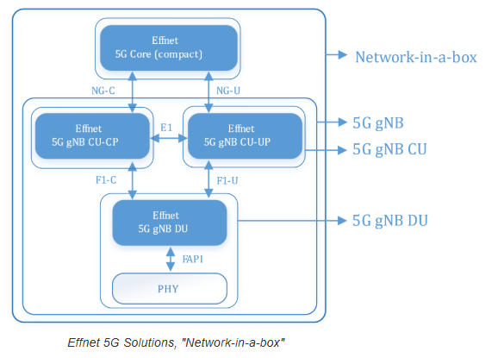
https://effnet.com/products/protocolstack-nw/?gad_source=2&gclid=EAIaIQobChMI6ePZsri4iwMVUSODAx1iqQF6EAEYASAAEgLnAfD_BwE

Slide 14
Outline of Presentation
5G RAN ARCHITECTURE Further Evoluation
‘LARGE RACK Implementation’: of 5G Split Open v-RAN Architecture revisited
Use Case 1: An exemplary illustration of the inter-gNB-DU handover scenario for vehicular communications.
‘ONE BOX NIB (Network-In-a-Box) Implementation’ : of 5G Split Open v-RAN Architecture with AI ADD on
Review on ‘5G/6G NIB’ (Network-In-a-Box)
Objective
Paper 1:
INTER-OPERABILITY among LARGE RAKE 5G and NIBs and their INTEGRATION
Use Case 2: IIIT KALYANI Debuts Smart Island (Running Project ) with DELL Servers having Intel® Xeon Gold 3.0 GHz 5317 x 2 processor
Project ‘SMART_GANGASAGAR ’ sponsored by DRDO: IIIT, KALYANI 5G O-RAN / V-RAN Architecture DEPLOYMENTS over SEA/ISLAND Communication at or surrounding Gangasagar with Five Cells
5G NIB with One Cell Use Case during Short Stretch of Journey over Sea Water Channel:
AI enabled 5G Vessels with 5G URLLC Slice operational at Gangasagar Island
5G NIB with Three CELLs Use cases during Long Stretch of Journey over Sea Water Channel: :
Ensuring Service Continuity in Integrated Terrestrial and Non-Terrestrial Network (TN-NTN) and Use Cases in Water Vehicles with Infotainment, IoT and IoV services
5G NIB with Five CELLs Use cases for above service extension at or nearby areas surrounding Gangasagar Island:
Design and Implementation of 5G-Advanced Infrastructure 2.0 based Private Network at nearby areas surrounding Gangasagar Island

Slide 15
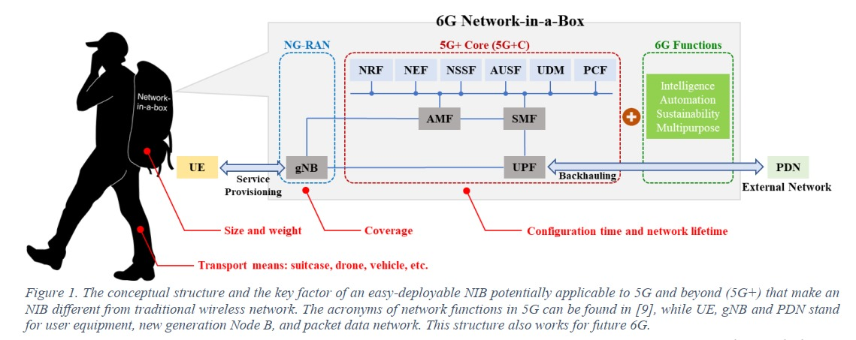
Objective for the development of NIB at IIIT , Kalyani :
5G/6G NIB Network-in-a-Box development at IIIT, KALYANI

Slide 16
Outline of Presentation
5G RAN ARCHITECTURE Further Evoluation
‘LARGE RACK Implementation’: of 5G Split Open v-RAN Architecture revisited
Use Case 1: An exemplary illustration of the inter-gNB-DU handover scenario for vehicular communications.
‘ONE BOX NIB (Network-In-a-Box) Implementation’ : of 5G Split Open v-RAN Architecture with AI ADD on
WEBINAR 1: Unlocking the True Potential of 5G with Network-in-a-box [ https://www.youtube.com/watch?v=5peyqzkgfXc&t=4s]
WEBINAR 2: Exploring the Benefits of 5G Labs for Colleges and Universities | Amantya Technologies [ https://www.youtube.com/watch?v=zh9XJPZlGQw]
Review on ‘5G/6G NIB’ (Network-In-a-Box): Paper 1
INTER-OPERABILITY among LARGE RACK 5G and NIBs and their INTEGRATION
Use Case 2: IIIT KALYANI Debuts Smart Island (Running Project ) with DELL Servers having Intel® Xeon Gold 3.0 GHz 5317 x 2 processor
Project ‘SMART_GANGASAGAR ’ sponsored by DRDO: IIIT, KALYANI 5G O-RAN / V-RAN Architecture DEPLOYMENTS over SEA/ISLAND Communication at or surrounding Gangasagar with Five Cells
5G NIB with One Cell Use Case during Short Stretch of Journey over Sea Water Channel:
AI enabled 5G Vessels with 5G URLLC Slice operational at Gangasagar Island
5G NIB with Three CELLs Use cases during Long Stretch of Journey over Sea Water Channel: :
Ensuring Service Continuity in Integrated Terrestrial and Non-Terrestrial Network (TN-NTN) and Use Cases in Water Vehicles with Infotainment, IoT and IoV services
5G NIB with Five CELLs Use cases for above service extension at or nearby areas surrounding Gangasagar Island:
Design and Implementation of 5G-Advanced Infrastructure 2.0 based Private Network at nearby areas surrounding Gangasagar Island

Slide 17
D. Zhu, M. Bilal and X. Xu, "Edge Task Migration With 6G-Enabled Network in Box for Cybertwin-Based Internet of Vehicles," in IEEE Transactions on Industrial Informatics, vol. 18, no. 7, pp. 4893-4901, July 2022, doi: 10.1109/TII.2021.3113879.
Abstract: In the Internet of Vehicles (IoV), various latency-critical and data-intensive applications have recently emerged to support smart traffic solutions. The sixth generation mobile networks (6G) greatly reduce the communication delay for the latency-critical tasks. However, the computing resources and execution efficiency for data-intensive tasks are still inadequate. The stationary edge computing (EC) servers, on the other hand, lack the flexibility to give service to moving vehicles. Therefore, Cybertwin is introduced in the IoV paradigm to provide a unified access point for EC. In addition, the 6G-enabled network in box (NIB) is deployed in vehicles to provide flexible computing power. However, in this article, the optimization of NIB task migration is still a challenge; thus, NIB task migration method (NTM) for IoV is proposed. Finally, NTM is evaluated by a real-world dataset of the service requests.

Slide 18
IN RECENT years, the development of Internet of Things (IoT) has driven the evolution of conventional vehicle ad-hoc networks (VANETs) into the Internet of Vehicles (IoV). The IoV provides a variety of intelligent applications based on mobile vehicles and technical support for unmanned driving.
Generally, all the vehicles in VANET are transformed into routing nodes that link each other to form a self-organizing network. When the vehicle is in high-speed displacement, there will be many breakpoints in VANET. The coverage of VANET is difficult to expand. In contrast, the IoV realizes the intercity interconnection of vehicles. The Cybertwin, a new technology that allows complete decoupling of control and base stations
(BSs), is introduced into IoV innovatively in this article to completely separate uplink and downlink, thus significantly improving spectrum utilization .
In the IoV, intelligent applications are aided by the provision of computational and storage resources . The current IoV, on the other hand, is suffering with unstable performance due to delays and a scarcity of resources. Furthermore, vehicle security necessitates very low network latency. To reduce the communication delay of various intelligent applications, it is necessary to upgrade the vehicular network . The emerging applications in IoV require higher real-time performance. Generally, the fifth generation mobile network (5G) is introduced
to meet such real-time needs . However, in the data-intensive City Center, 5G cannot provide stable and high-quality real-time performance due to the huge amount of data (such as the video of dashcam, the video of edge road monitoring, etc.) generated in unit time . Therefore, 6G is promising to cope with the huge amount of data transmission with its peak data transmission speed of 1 TB/s. With 6G, after reducing the communication delay, IoV will still suffer from the lack of computing and storage resources.

Slide 19
To provide computing and storage resources for the IoV, the cloud platform is introduced. Due to the huge amount of data in the IoV, it is difficult for the cloud platform to deal with the tasks from various intelligent applications timely, effective, and real-time manner. Therefore, edge computing (EC) is widely employed in the IoV to provide computing and storage resources at the edge of the IoV and reduce the burden of the cloud
platform . The edge servers (ESs) are usually deployed in fixed locations, such as edge BSs and wireless APs. However, vehicles in the IoV are in high-speed displacement. The traditional deployment mode of the ESs is relatively fixed, which makes the ESs unstable when providing services for vehicles. The 6G-enabled network in box (NIB) realizes a flexible solution for EC . NIBs that deployed on every vehicle in the IoV not only integrate the 6G communication interface but also provide individual computing and storage capabilities. Through the deployment of NIBs, the computing and storage resources of EC are closer to the vehicle.
However, NIBs have limited computing and storage resources. When an NIB resource cannot handle local tasks, some tasks need to be offloaded to other NIBs in order to avoid queuing and get timely results. Although the transmission delay has been greatly reduced in 6G, the new communication carrier also brings some new problems. The terahertz frequency band is easily interfered with by distance and obstacles. During task migration, packet loss and other negative effects caused by interference will appear. In addition, some NIBs will be overloaded when the task is offloaded. In order to reduce the execution delay, the efficiency of NIBs should also be fully considered.

Slide 20
When an NIB in IoV generates a task, and if the computational power of the NIB is deficient to complete the task, the task needs to be migrated to other NIBs with sufficient computational power.
First, the NIB encapsulates the tasks to be migrated and send them to the edge BS. The NIB connects to
Cybertwin through its interface and uploads tasks to its digital twin. Cybertwin distributes the tasks to the digital twin of the ES by using the aggregated information it manages. Then, this digital twin submits the task to the actual corresponding ES.
The edge BS marks this NIB as a full load NIB in the subrouting table maintained in real time. Then, the edge BS establishes a communication connection with the 6G communication satellite and sends the encapsulated tasks to the satellite. Combining with task information and routing table, the control center calculate the optimal migration strategy under the condition of satisfying three objective functions. According to the optimal migration
strategy, the task is migrated to the specified NIBs. After the task is processed, all target NIBs destroy the data of tasks and release the resources in time and return the results to the edge BSs.
The edge BSs will return the result to 6G communication satellite. Finally, the 6G satellite sends the result to the primary NIB. Since multihop communication between BSs increases the physical delay of communication, the task needs to be forwarded via 6G satellite to ensure low latency reliability when direct communication between BSs is not available.
The process of task migration is shown in Fig. 2. The pink arrows in Fig. 2 represent the tasks being migrated out. The paths indicated by the blue arrows are planned by the migration policy. The final results follow the paths of the green arrows back.

Slide 21
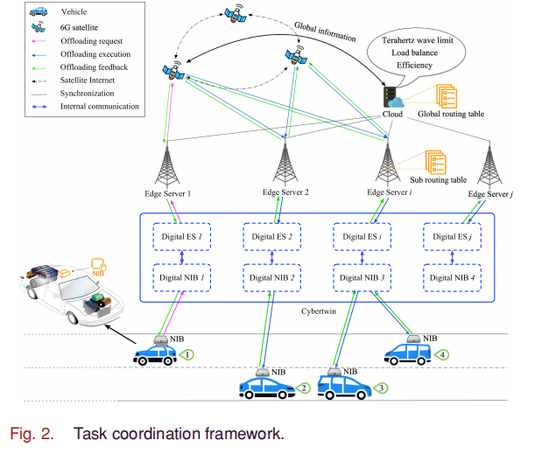

Slide 22
Outline of Presentation
5G RAN ARCHITECTURE Further Evoluation
‘LARGE RACK Implementation’: of 5G Split Open v-RAN Architecture revisited
Use Case 1: An exemplary illustration of the inter-gNB-DU handover scenario for vehicular communications.
‘ONE BOX NIB (Network-In-a-Box) Implementation’ : of 5G Split Open v-RAN Architecture with AI ADD on
Review on ‘5G/6G NIB’ (Network-In-a-Box)
Objective
Paper 1:
Paper 2:
INTER-OPERABILITY among LARGE RACK 5G and NIBs and their INTEGRATION
Use Case 2: IIIT KALYANI Debuts Smart Island (Running Project ) with DELL Servers having Intel® Xeon Gold 3.0 GHz 5317 x 2 processor
Project ‘SMART_GANGASAGAR ’ sponsored by DRDO: IIIT, KALYANI 5G O-RAN / V-RAN Architecture DEPLOYMENTS over SEA/ISLAND Communication at or surrounding Gangasagar with Five Cells
5G NIB with One Cell Use Case during Short Stretch of Journey over Sea Water Channel:
AI enabled 5G Vessels with 5G URLLC Slice operational at Gangasagar Island
5G NIB with Three CELLs Use cases during Long Stretch of Journey over Sea Water Channel: :
Ensuring Service Continuity in Integrated Terrestrial and Non-Terrestrial Network (TN-NTN) and Use Cases in Water Vehicles with Infotainment, IoT and IoV services
5G NIB with Five CELLs Use cases for above service extension at or nearby areas surrounding Gangasagar Island:
Design and Implementation of 5G-Advanced Infrastructure 2.0 based Private Network at nearby areas surrounding Gangasagar Island

Slide 24
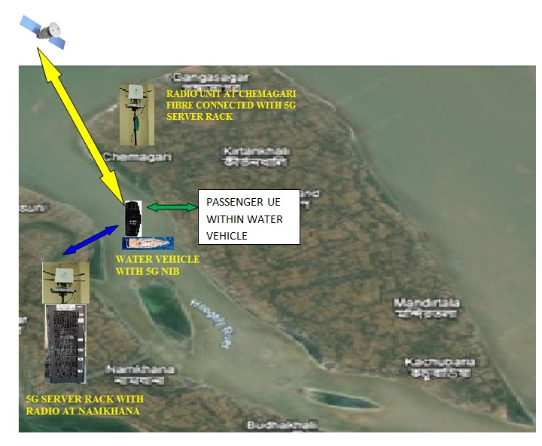
5G NIB with Three CELLs Use cases proposed to be developed at IIIT, KALYANI during Long Stretch of Journey over Sea Water Channel at GANGASAGAR :

Slide 25
SIMILAR
INTER-OPERABILITY among LARGE BASE STATION and NIB
USE CASE 1 in ROAD VEHICLE with 140 GHZ RADIO
Published one IEEE High End Journal
INTER-OPERABILITY among IIIT KALYANI ‘s LARGE BASE STATION and NIB
USE CASE 2 in WATER VEHICLE at SMART GANGASAGAR

Slide 26
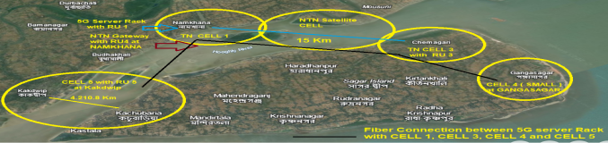
5G NIB with Five CELLs Use cases for above service extension at or nearby areas surrounding Gangasagar Island:
Fig : Private virtualized 5G-Advanced network at or nearby Gangasagar Island to solve majority of Communication problems of Under-served /unserved water channel and Crowded areas at Kapil Muni Temple, Gangasagar .

